Slide 1
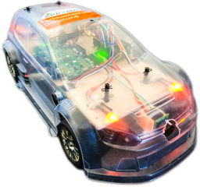
Developing a Multicore RC-Car with APP4MC
Mustafa Özçelikörs, Robert Höttger
EclipseCon Ludwigsburg, Germany
26.10.2016

Slide 2
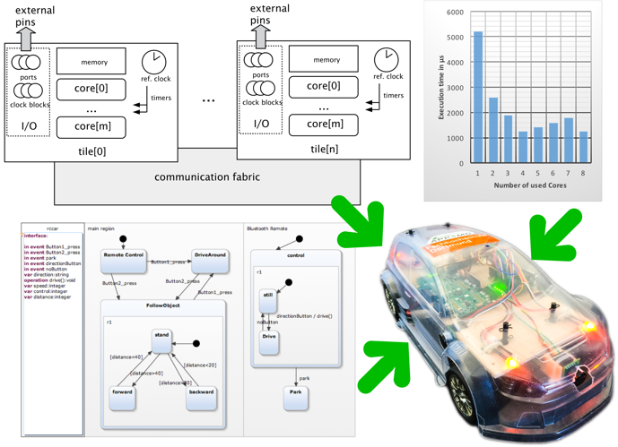
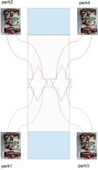
RC Car

Slide 3
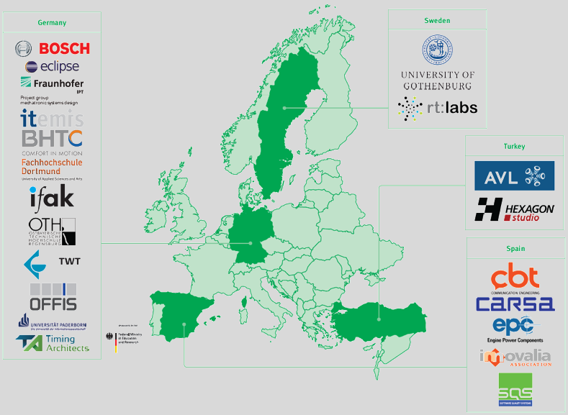
APP4MC (aka Amalthea) I
An open source development platform for embedded multi- and many-core systems
Itea2 project
German funding by BMBF
20 partners
7,8 mio€
80 person years
Sep.2014 – Aug.2017
Notes:
Who?
Project

Slide 4
APP4MC (aka Amalthea) II
Notes:
What?

Slide 5
APP4MC (aka Amalthea) III
Notes:
What?
Requirements, System Architecture, System design, Software architecture, Software implementation
Unit Test, Integration Test, System, System integration, Use

Slide 6
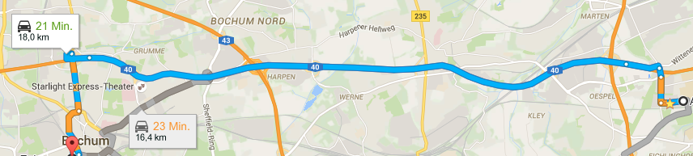
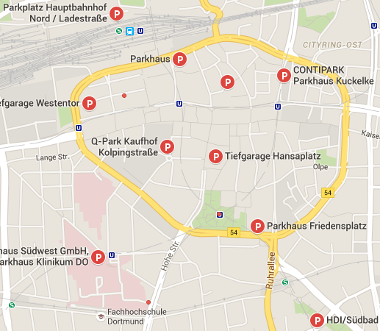
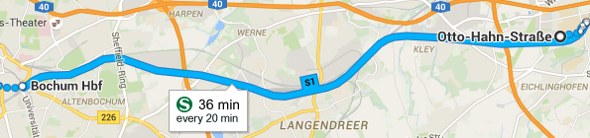
Challenges I
Platform provides interfaces to allow individual tool-chain tailoring based on a common format
→ open standard, increased interoperability and data exchange
Costs
Time
Resources
Environment
Traffic
Hardware
Dependencies
Infrastructure
Speed
Notes:
Why?

Slide 7
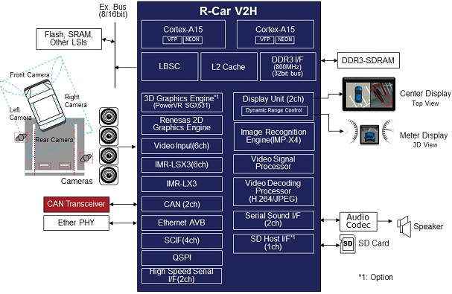
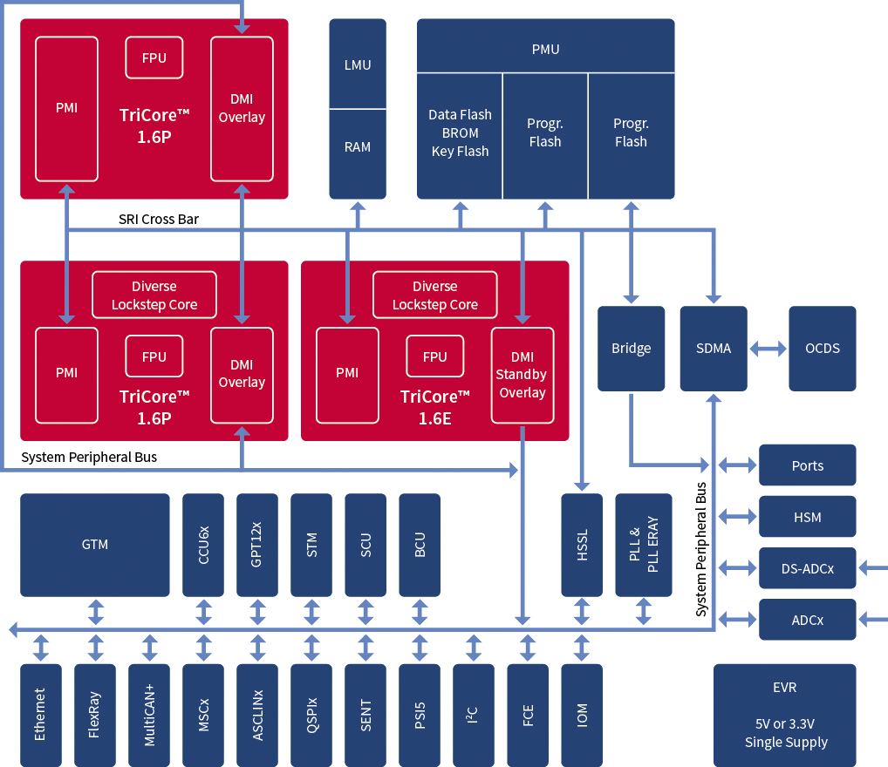
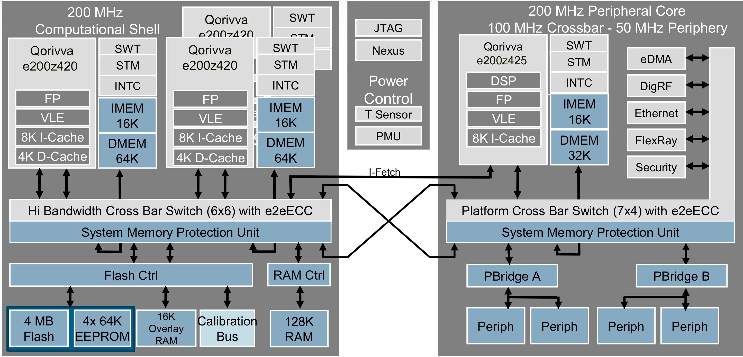
Challenges II
Source: www.autosar.org
Source: www.renesas.eu
Source: www.infineon.com
Source: www.nxp.com

Slide 8
From multi-core to many-core
Multi-core
Few homogeneous cores with shared memory
Symmetric communication (e.g. crossbar)
Limited influence to software distribution
Many-core
High amount of homogeneous and heterogeneous cores, distributed memory
Heterogeneous communication (non uniform memory access)
High influence to software distribution

Slide 9
Embedded Multicore
Software distribution and memory mapping defines
Response time
Core utilization
Energy consumption
Costs
Efficiency
Durability
...
Automation safes efforts, creates better solutions and is less error prone

Slide 10
Task Management

Slide 11
Task Distribution

Slide 12
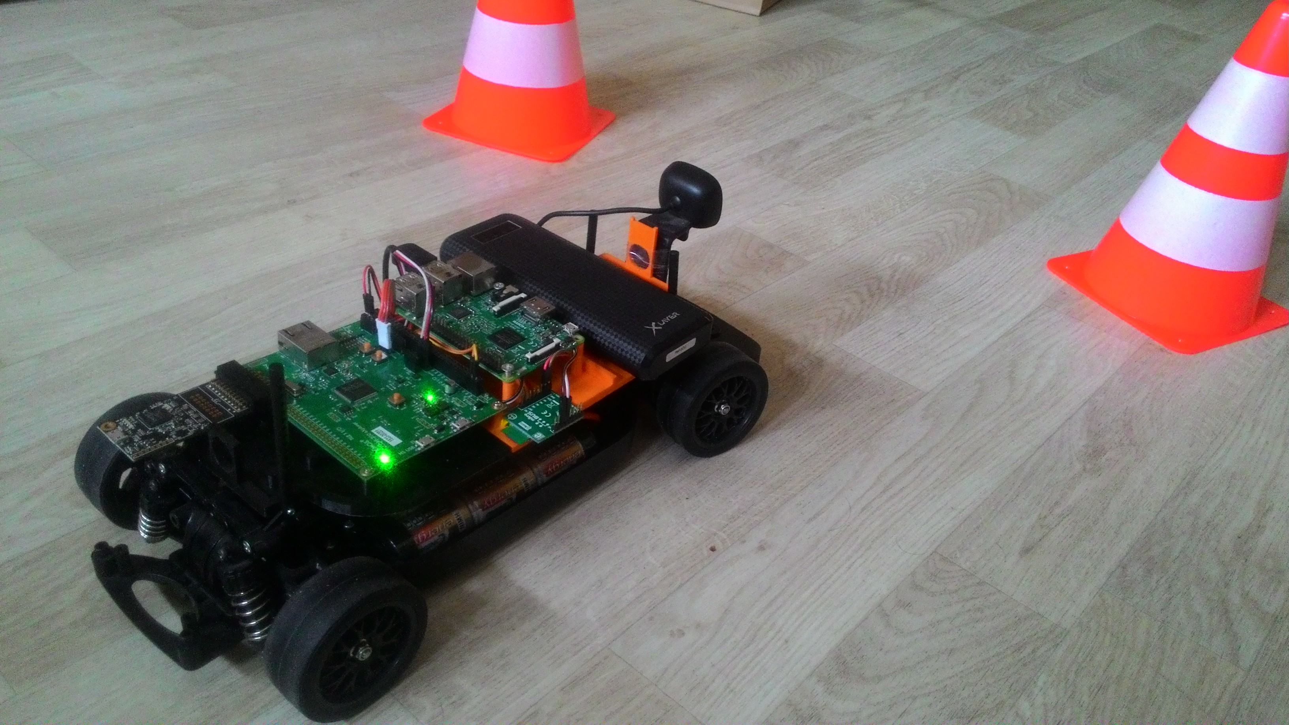
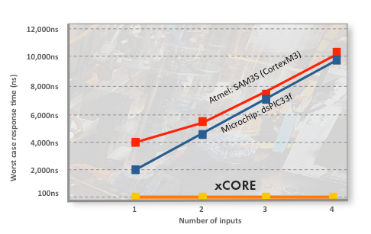
RCCar
XMOS XE-216 Multicore
16 logical cores, 2 tiles
Single cycle instruction execution
Programmed with xC
A C extension with
Event mechanism
Client-server ports
Software components
Interfaces, Streaming channels
Source: XMOS
Notes:
-- xC resembles SystemC a lot.

Slide 13
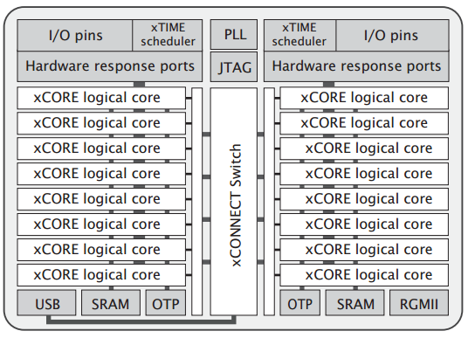
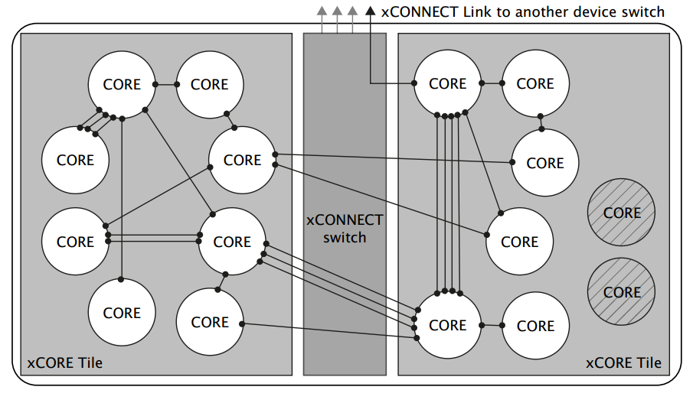
XMOS Overview
XMOS Overview
Tile: Each tile has their dedicated memory, I/O pins and scheduler.
xTIME Scheduler
xCONNECT Switching between tiles
Core placement options of tasks
Combined
Distributed
Pictures: XE-216 Datasheet
Notes:
Combined tasks: event-driven tasks that can be combined in one core.
Distributed tasks: tasks that can be run on any core, depending on the requested connections

Slide 14
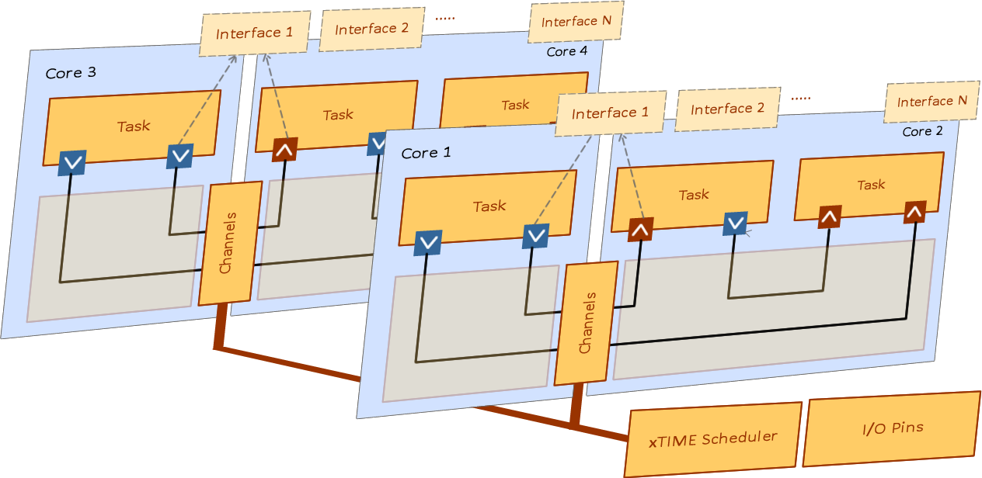
XMOS Architecture
Multiple processing cores – Runs multiple tasks concurrently
• Immediate response time – 100x faster than other MCUs
• Flexible ports and peripherals – Supports fast complex interfaces – Multiple peripherals in one chip
• RTOS features in hardware – Scheduler, timers, communications – Predictable repeatable behavior – Low latency
• Integrated development tools – Programmed in C and C++ – Instrumentation/trace libraries – Static timing analyzer
• Multicore extensions for C – Concurrent tasks, timing, communication, I/O, memory management
Source: XMOS xCORE Architecture Flyer
Notes:
https://www.xmos.com/download/private/xCORE-Architecture-Flyer%281.1%29.pdf

Slide 15
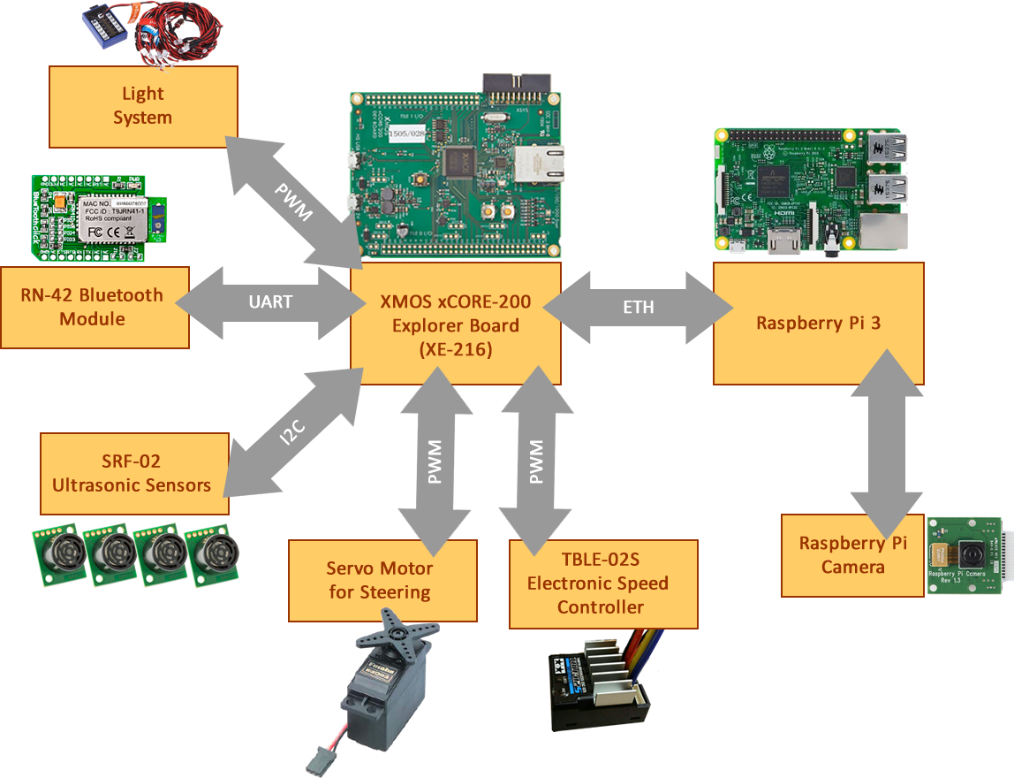
RCCar
System Hardware Overview
4xSRF02 Sonar Rangefinders
Uses I2C bus
RCCar Electronic Speed Controller
Uses PWM, 0 to 20ms period
Servo Motor
Uses PWM, 0 to 20ms period
RN-42 Bluetooth Module
Uses UART, 115200bps
Raspberry Pi
Connnected via RGMII Ethernet
Can support 10/100/1000 Mbps
Notes:
Reduced Gigabit Media Independent Interface (RGMII) specifies a particular interface between an Ethernet MAC and PHY.
RGMII uses half the number of pins as used in the GMII interface. This reduction is achieved by clocking data on both the rising and falling edges of the clock, and by eliminating non-essential signals (carrier-sense and collision-indication). Thus RGMII consists only of: RXC, RD[3:0], RX_CTL, TXC, TXD[3:0], and TX_CTL (12 pins, as opposed to GMII's 24).
Unlike GMII, the transmit clock signal is always provided by the MAC on the TXC line, rather than being provided by the PHY for 10/100 Mbit/s operation and by the MAC at 1000 Mbs.
RGMII supports Ethernet speeds of 10 Mbit/s, 100 Mb/s and 1000 Mbit/s.

Slide 16
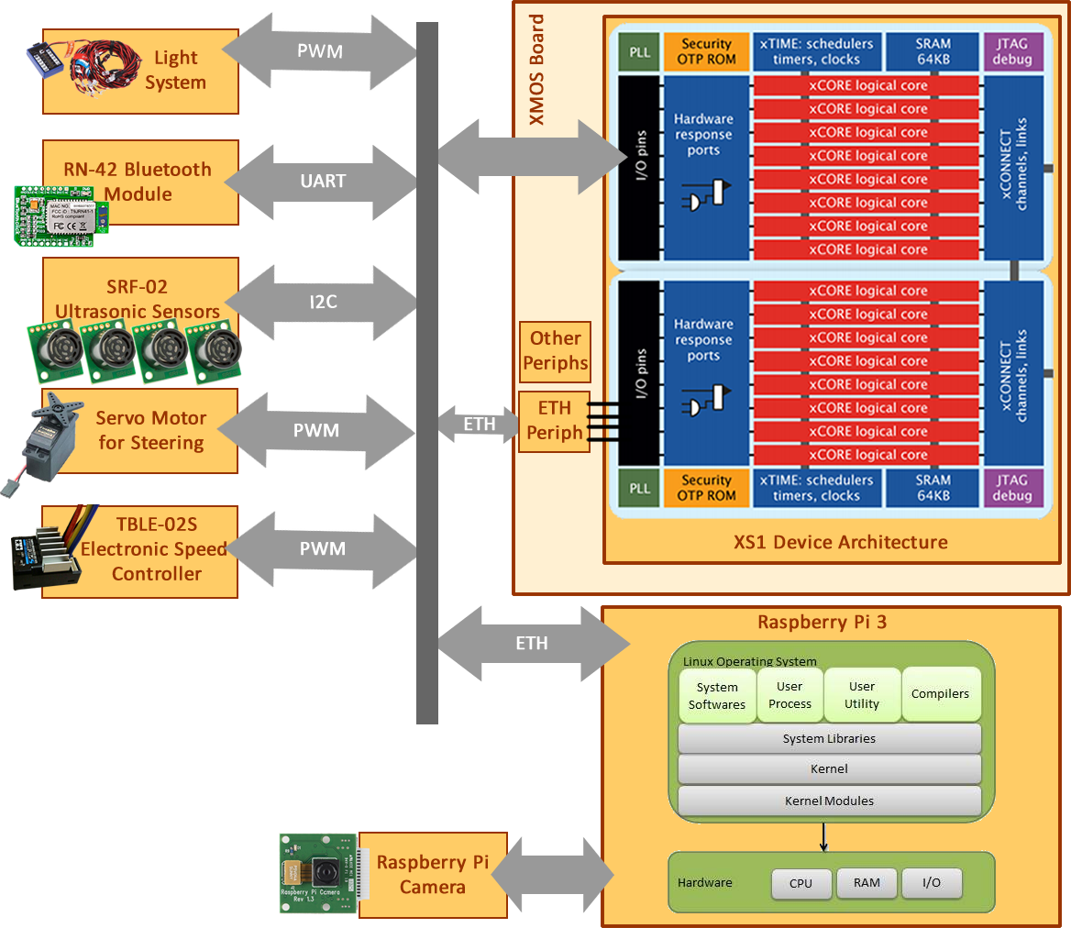
System Overview
Notes:
Reduced Gigabit Media Independent Interface (RGMII) specifies a particular interface between an Ethernet MAC and PHY.
RGMII uses half the number of pins as used in the GMII interface. This reduction is achieved by clocking data on both the rising and falling edges of the clock, and by eliminating non-essential signals (carrier-sense and collision-indication). Thus RGMII consists only of: RXC, RD[3:0], RX_CTL, TXC, TXD[3:0], and TX_CTL (12 pins, as opposed to GMII's 24).
Unlike GMII, the transmit clock signal is always provided by the MAC on the TXC line, rather than being provided by the PHY for 10/100 Mbit/s operation and by the MAC at 1000 Mbs.
RGMII supports Ethernet speeds of 10 Mbit/s, 100 Mb/s and 1000 Mbit/s.

Slide 17
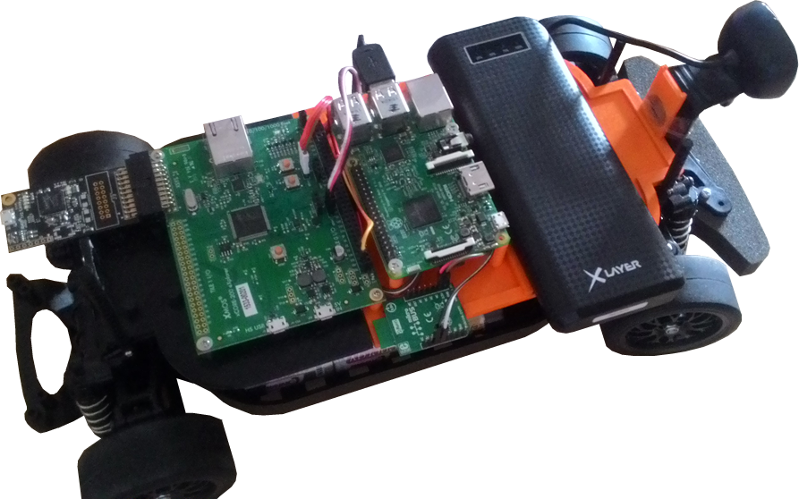
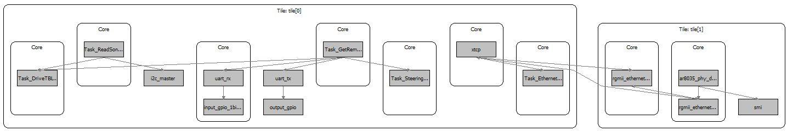
Initial Task Partitioning
Main Tasks
Task 1: Read Sonar Sensors
Task 2: Serial Port Connection
Task 3: Drive Steering Servo Motor
Task 4: Drive Motor Driver
Task 5: Get Remote Bluetooth Commands
Task 6: Maintain I2C Connection
Task 7: TCP Connection
Task 8: Ethernet Driver
Task 9: TCP Server
1
5
7
2.1
2.2
4
6
3
9
8

Slide 18
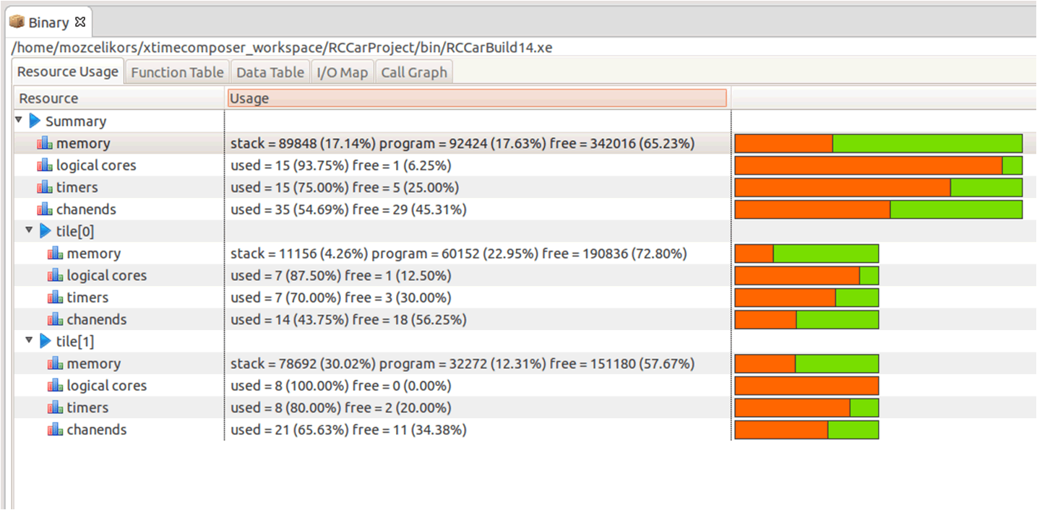
Modeling the System with APP4MC
xTIMEComposer provides Binary information about the projects.
Stack sizes
Task precedence
I/O Map
Interfaces
Hardware / other resources
This information is useful to model with APP4MC.

